Slide 1
Linking Census and Enterprise Data Sets
Deborah M Cooper
@DeborahMCooper
Deb@DeborahMCooper.com

Slide 2
Why Link Census and Enterprise Data Sets?
Monetize
Connect
Identify

Slide 3
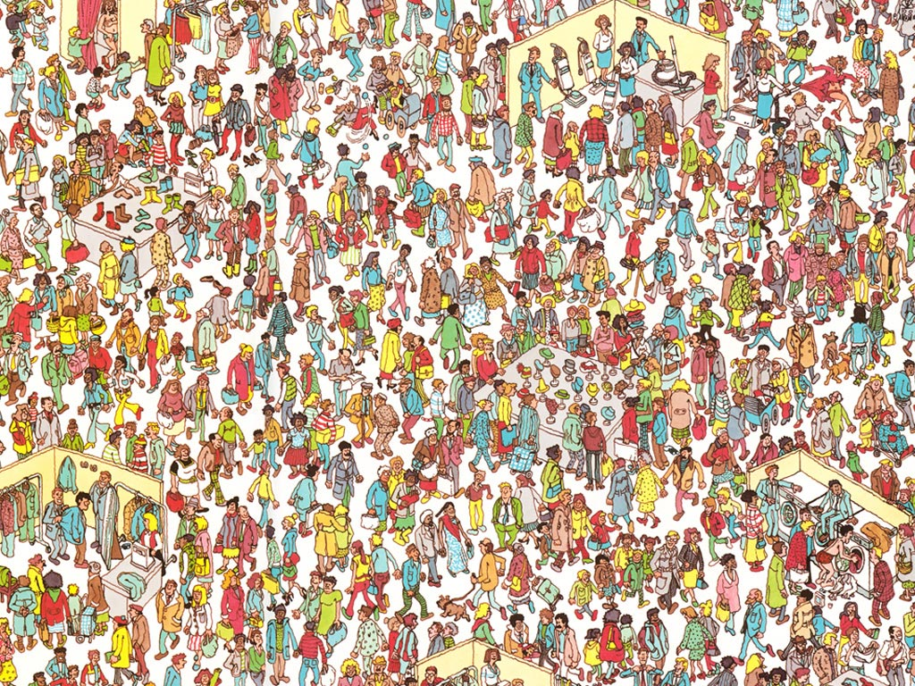
Where’s Waldo?
FindWaldo.com © 2008 Entertainment Rights Distribution Limited.

Slide 4
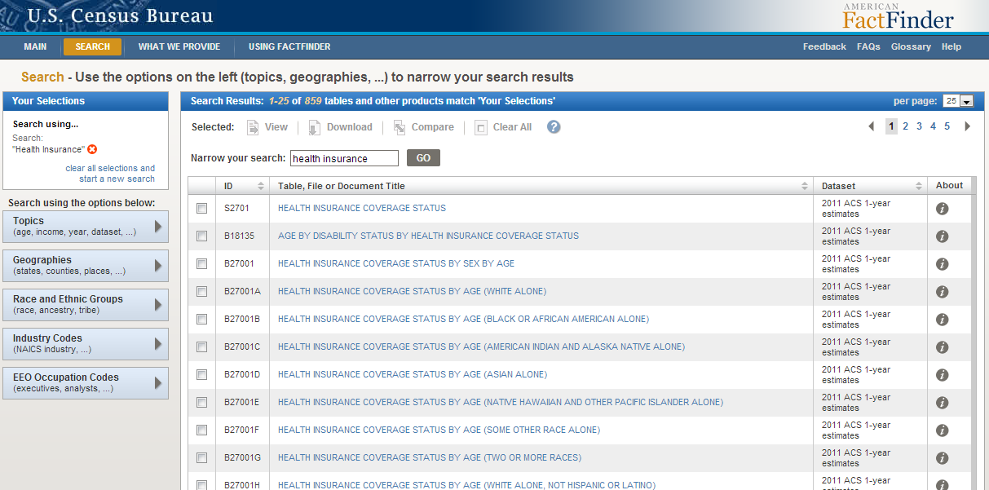

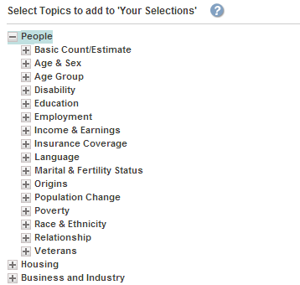
Census Data Revealed

Slide 5
Identify your Target Market
US Health Insurance Buyers
Over 65 years
40 million
Under 18 years
74 million
18 to 64 years
193 million
S2701: Health Insurance Coverage Status.
Source: U.S. Census Bureau, 2011 American Community Survey

Slide 6
Identify your Target Market
Insurance Coverage by Metropolitan Statistical Area (MSA)
B27011: Health Insurance Coverage Status and Type by Employment Status by Age.
Universe: Civilian non-institutionalized population 18 years and over.
Source: U.S. Census Bureau, 2011 American Community Survey

Slide 7
Connect with your Target Market
Integrated Media
Table 1133. Multimedia Audiences--Summary: 2010.
Universe: Civilian non-institutionalized population 18 years and over.
U.S. Census Bureau, Statistical Abstract of the United States: 2012 (131st Edition) Washington, DC, 2011;

Slide 8
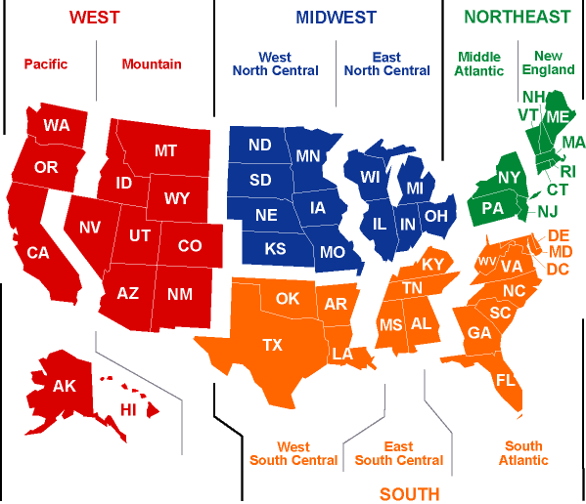
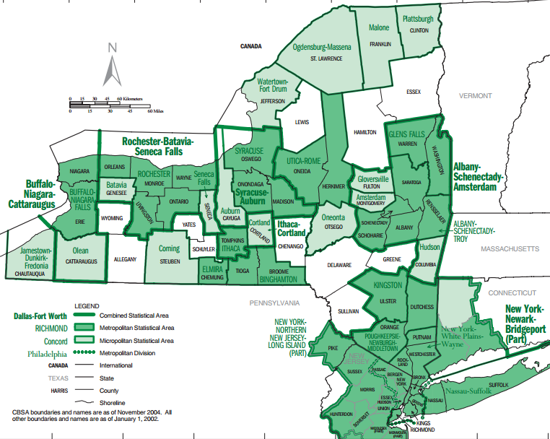
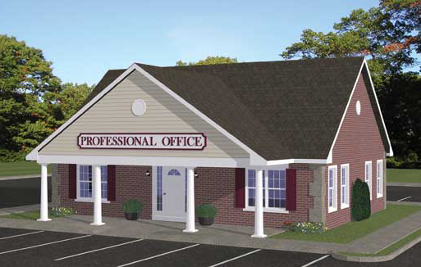
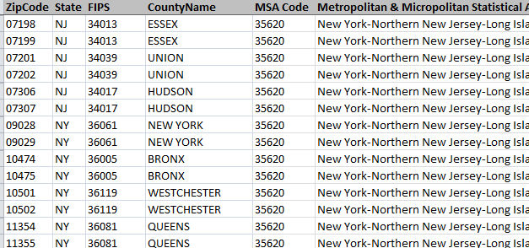
Monetize your Target Market
Linking Census to Enterprise Data
WEST
MIDWEST
NORTHEAST
SOUTH

Slide 9
Monetize your Target Market
Agency Distribution
 |  |  |  | Company A |  | Company B |  | Company C
 | Metropolitan Statistical Area | 18 – 64 Market | Percent Uninsured | Count of Branches | Sat. Level | Count of Branches | Sat. Level | Count of Branches | Sat. Level
NE | New York | 12M | 19% | 73 | Med | 18 | Low | 286 | High
 | Philadelphia | 4M | 14% | 48 | High | 17 | Med | 103 | High
 | Boston | 3M | 6% | 13 | Med | 1 | Low | 10 | Med
South | Dallas | 4M | 29% | 49 | High | 21 | Med | 300 | High
 | Houston | 4M | 31% | 40 | High | 8 | Low | 254 | High
 | Washington DC | 4M | 15% | 50 | High | 10 | Low | 121 | High
 | Miami | 4M | 36% | 26 | Med | 26 | Med | 198 | High
 | Atlanta | 3M | 26% | 39 | High | 28 | Med | 153 | High
 | Baltimore | 2M | 12% | 32 | High | 7 | Med | 73 | High
 | Tampa | 2M | 26% | 19 | High | 26 | High | 85 | High
Midwest | Chicago | 6M | 21% | 36 | Med | 171 | High | 429 | High
 | Detroit | 3M | 18% | 23 | Med | 25 | High | 138 | High
 | Minneapolis | 2M | 11% | 6 | Low | 85 | High | 138 | High
 | St. Louis | 2M | 16% | 11 | Med | 69 | High | 84 | High
West | Los Angeles | 8M | 29% | 19 | Low | 12 | Low | 591 | High
 | San Francisco | 3M | 16% | 14 | Med | 2 | Low | 251 | High
 | Riverside, CA | 3M | 28% | 7 | Low | 2 | Low | 131 | High
 | Phoenix | 3M | 23% | 19 | Med | 60 | High | 185 | High
 | Seattle | 2M | 18% | 16 | Med | 55 | High | 180 | High
 | San Diego | 2M | 24% | 12 | Med | 6 | Med | 119 | High
Census (ACS) data:
18 to 64 year old market
Percent uninsured
Enterprise data:
Count of Branches
Derived from Census and Enterprise data:
Saturation Level

Slide 10
Additional Markets
Health Insurance (American Community Survey)
Internet Consumers (Current Population Survey, Consumer Expenditure Survey)
Business-to-Business (Economic Census)

Slide 11
Linking Census and Enterprise Data Sets
Identify
Marketing
Connect
Sales
Monetize

Slide 12
Thank you!
Deborah M Cooper
@DeborahMCooper
Deb@DeborahMCooper.com
Kind acknowledgements to Cavan Capps and Doug Hillmer, US Census Bureau.

Slide 13
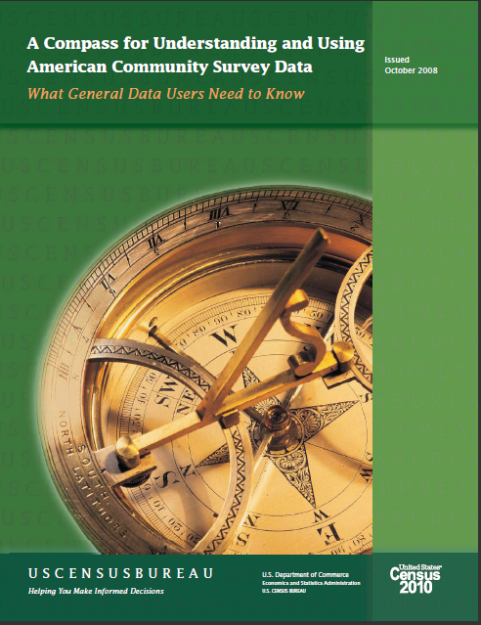
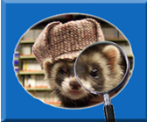
For more information…
Sources
  American Fact Finder (factfinder2.census.gov)
  Data Ferret (dataferrett.census.gov)
Help with Census Data and Access
  Census Bureau Customer Help Center: 1-800-923-8282
  Demographic Call Center: 301-763-INFO (4636) or 1-866-758-1060
  Or submit a question online at ask.census.gov.

